Slide 1
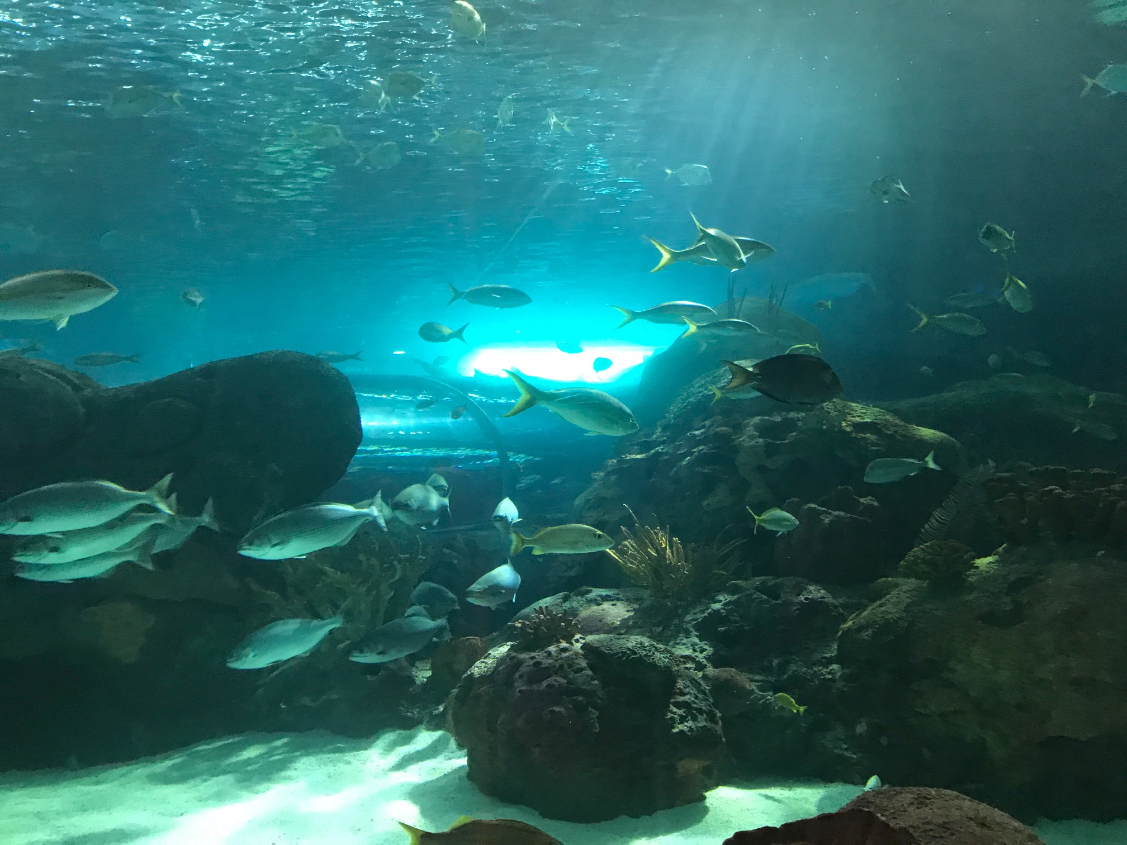
North-Shore Tech
Taking you beyond the cloud

Slide 2

We are a state of the art one stop shop for your DevOps and Cloud technology needs, serving customers out of Lagos, Nigeria, we are poised to shape and grow the adoption of cloud technologies in our region.
Vision

Slide 3

Consulting
Our consulting line of business offers various products to serve our customers
Exploratory Solution analysis - a snap-shot audit of your environment
Advisory - where you engage our expertise to provide guidance and expertise counsel on which, why and how selected technologies will fit into your existing environment

Slide 4
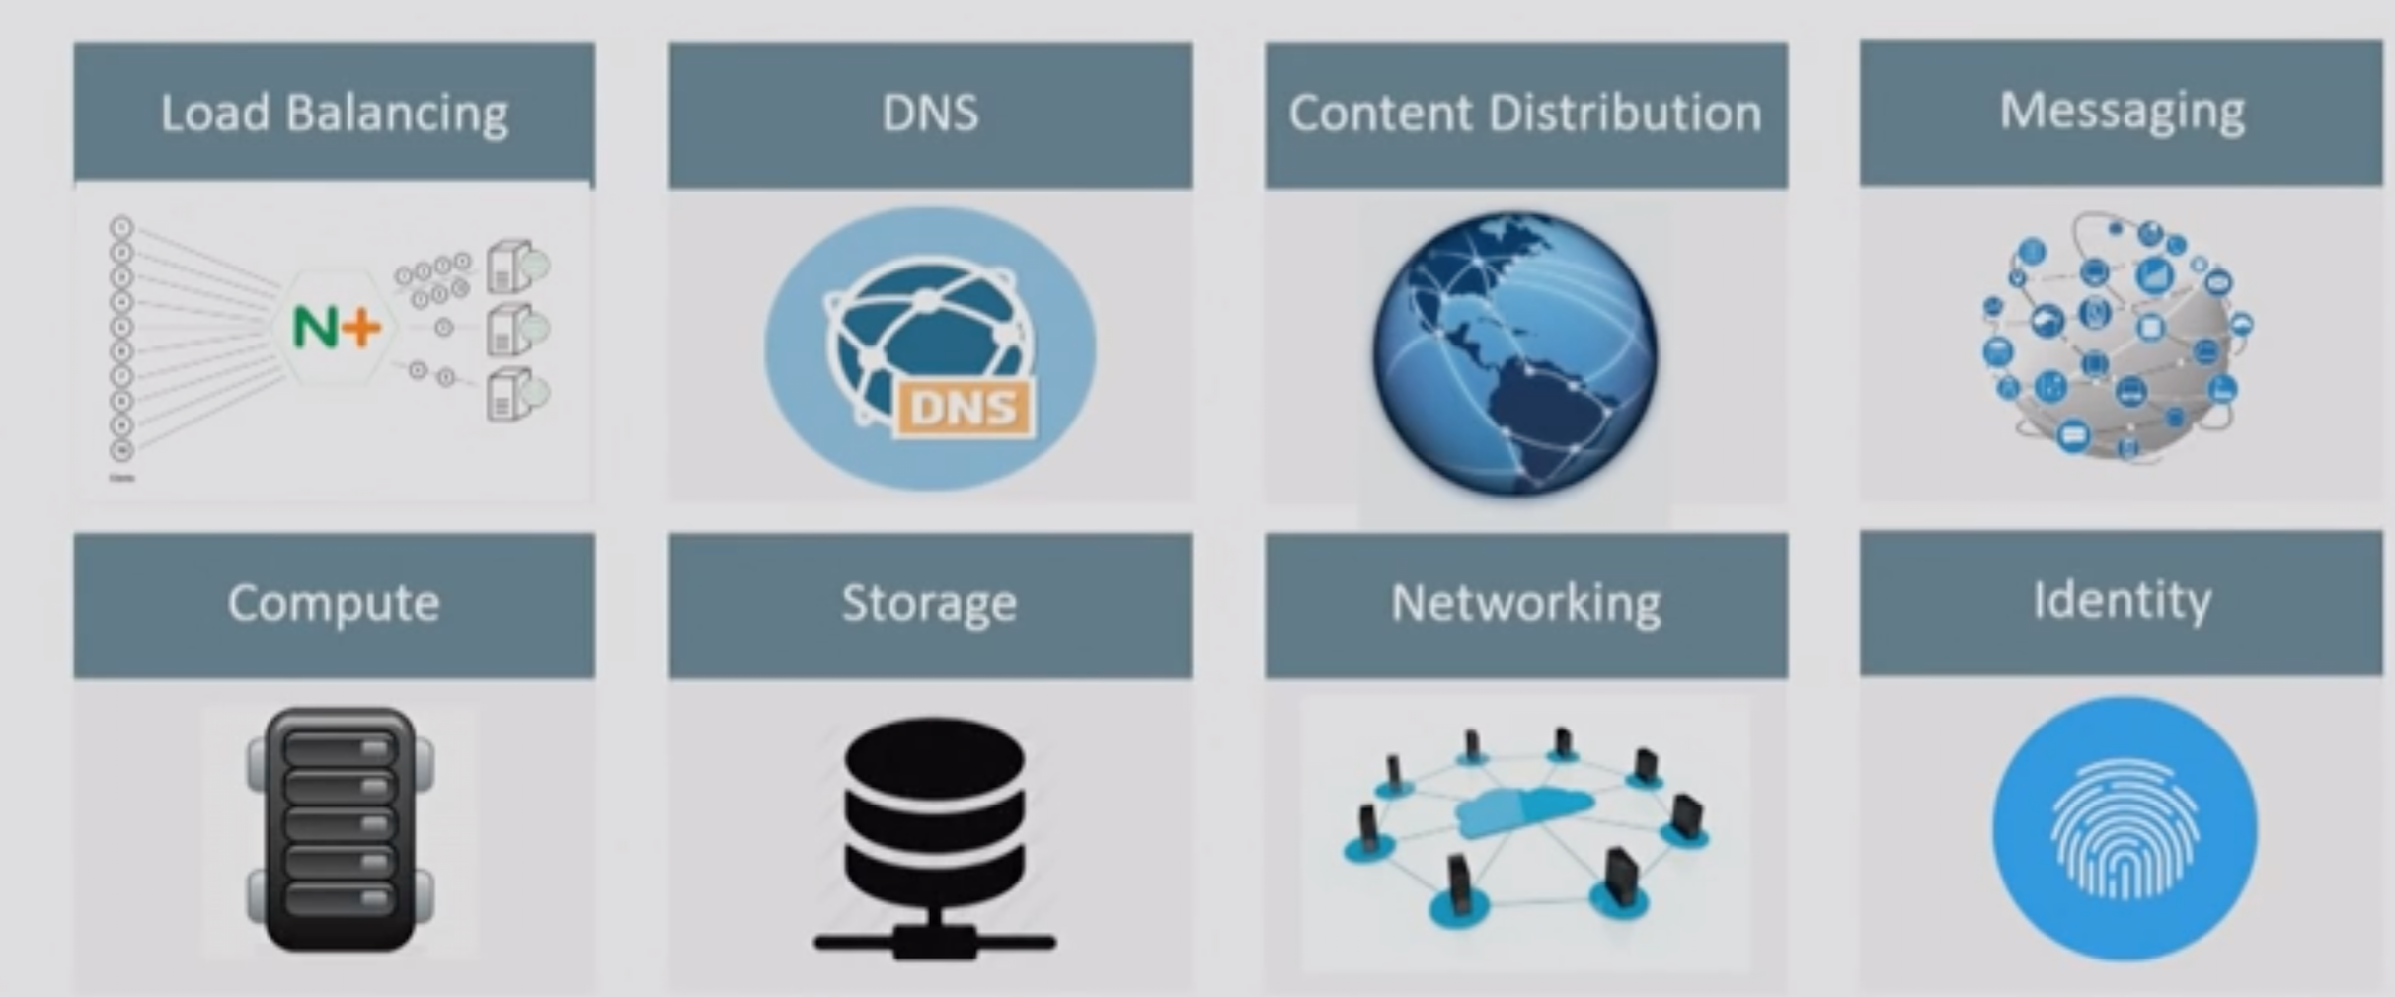
We don’t just tell you what to do, we do it for you
Implementation

Slide 5
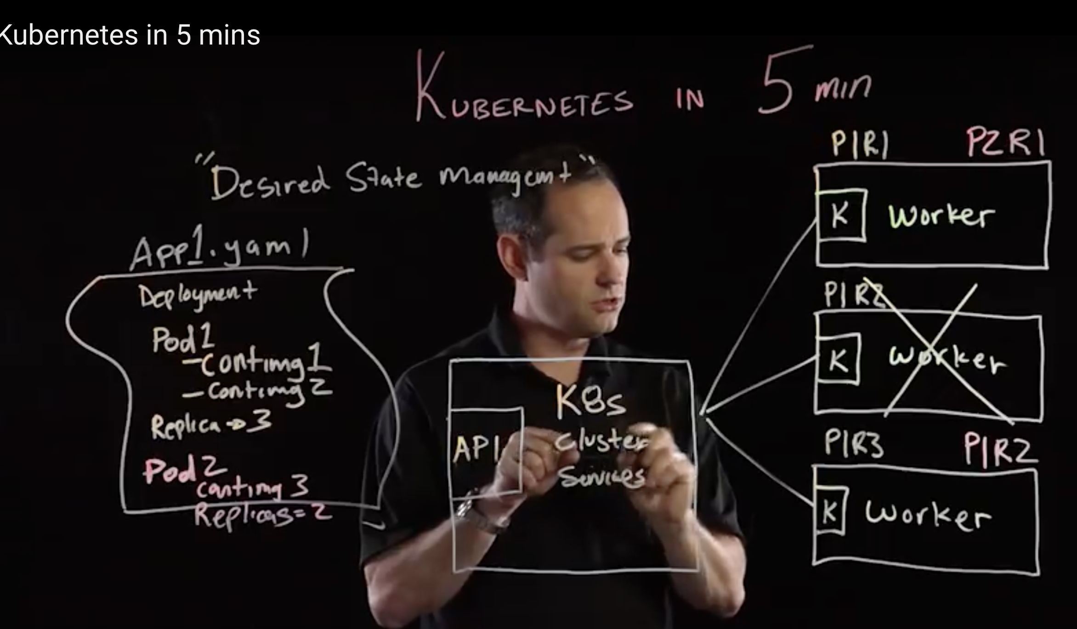
We offer training in DevOps, AWS, GCP and Azure cloud technologies
Training

Slide 6
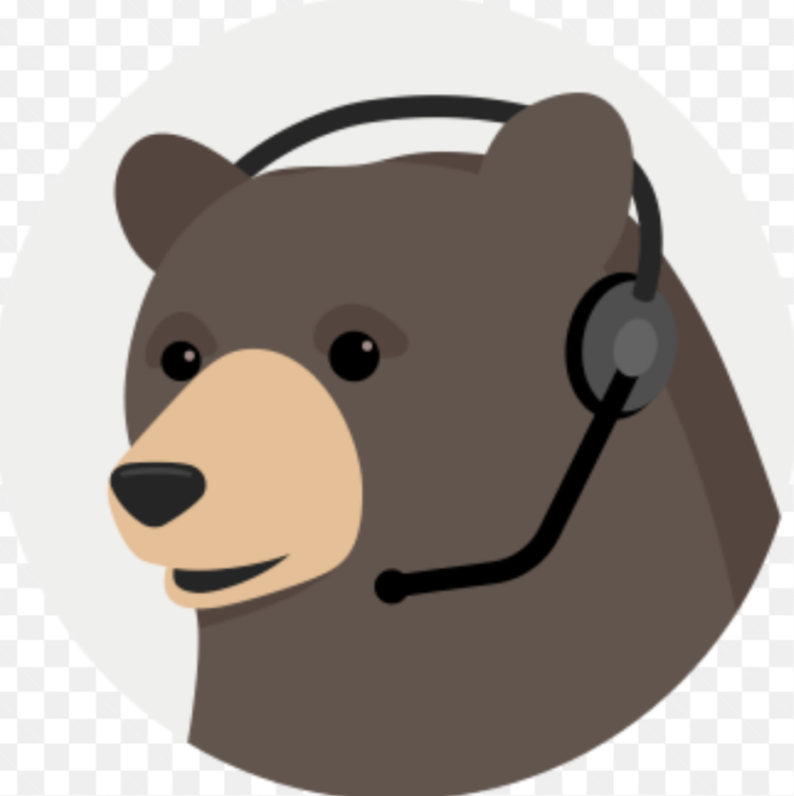
Support
After implementations we also offer post-implementation support for product launches and project milestones.
Comes in Premium, standard and basic

Slide 7
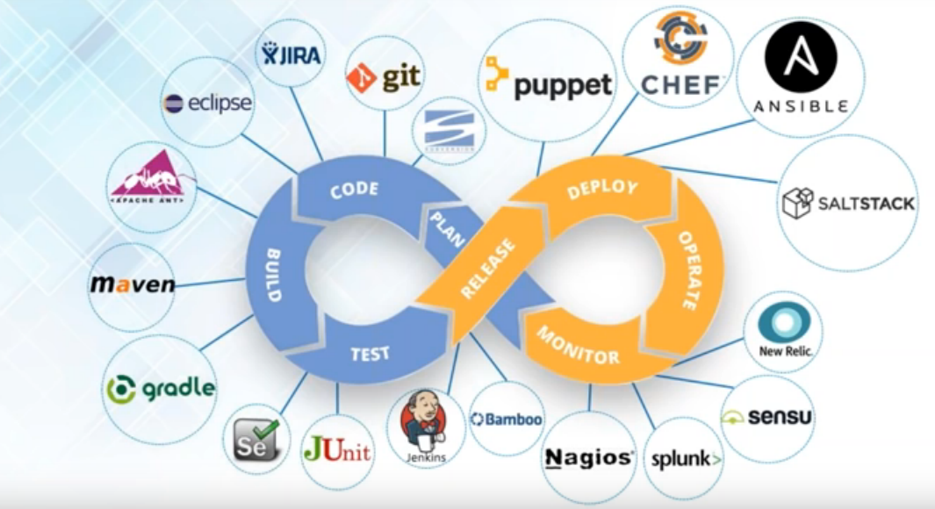
We support our customers with a variety of DevOps tools
DevOps Tooling

